Slide 1
Legislative/Policy Update
NW Portland Area Indian Health Board
Quarterly Board Meeting
June 20, 2012

Slide 2
Overview
FY 2013 IHS Appropriation
CSC Supreme Court Decision
GAO CHS Funding Study
Insurance Exchanges
TTAG Updates
Questions

Slide 3
FY 2013 Appropriations
Twelve Appropriations bills
House and/or Senate Action on 11 bill bills; none have been passed full chamber
Interior & Environment is one bill that House or Senate have not taken action
  June 20^{th,} 1:00 PM mark up scheduled
  Witness Hearings March 27-29th
  Andy Joseph was witness

Slide 4
Discretionary Budget Caps
Subcommittee | FY 2012 | FY 2013
Agriculture | $17,250 | $19,405
Homeland Security | $40,592 | $39,117
Interior & Environment | $27,473 | $28,000
Labor, HHS & Education | $139,218 | $150,002
Defense | $530,025 | $519,220
Commerce, Justice, Science | $50,237 | $51,129

Slide 5
IHS FY 2013 President’s Request
President’s Request $115.9 million increase; 2.7%
NPAIHB analysis estimates $403 million to maintain current services
  Inflation: $213.5 million
  Population Growth: $90.4 million
  CSC Shortfall: $99.3 million
IHS CJ explains Detail of Changes:
  Current Services: $85.6 million for Federal Pay costs, medical inflation, staffing new facilities
  Program Expansion: $30.3 million for CHS, Health IT (ICD-10), Direct Ops, CSC, M&I
  Program Decrease in Facilities Construction $3.5 million

Slide 6
IHS FY 2013 President’s Request
Current Services: $85.6 million
  Federal Pay Costs $2.4 million
  Medical Inflation $33.9 million
  Staffing new facilities $49.3 million
Program Increases (Reprogramming)
  CHS increase $20 million
  HIT ICD-10 $6 million
  Direct Operations $1.1 million
  Contract Support Costs $5 million
  Maintenance & Improvement $1.5 million
  Health Facilities Construction $3.6 million

Slide 7
Contract Support Cost Update
New interest in CSC issues driven by funding
  FY 2010 $116 million increase; 41% increase
  FY 2012 $74 million increase; 19% increase
  FY 2013 $5 million; will drive up shortfall
IHS Director reconvened the Contract Support Cost Workgroup – Andy Joseph, Jr., Chairperson
First Workgroup Meeting Mar. 31-Feb. 1, 2012
  Charged to evaluate changes for “new/expanded programs”
  Impasse with the IHS Director about data
Second Workgroup Meeting May 3-4, 2012
  Same issues continue

Slide 8
CSC Workgroup Issues
CSC Workgroup requests the following:
  IHS Disclosure of CSC data to analyze impact of CSC policy change for new & expanded programs
  Data provides basis of developing recommendations
  IHS Redline of CSC Policy changes
  Concerns about application of FACA
  Next meeting date?

Slide 9
CSC Supreme Court Decision
Supreme Court reached decision in Salazar v. Ramah Navajo Chapter (Zuni) case
Case brought by Federal Government (BIA) arguing that notwithstanding the CSC "cap" language in the annual appropriations, it is not obligated to fully fund CSC’s
Case decided by narrow margin 5-4
This means that IHS/BIA must pay full CSC costs if Agencies have enough appropriated funds and does not matter if they do not have adequate CSC funding

Slide 10
GAO Study on CHS Funding
IHCIA requires GAO review of CHS allocation and make recommendations to address funding inequity
GAO reviewed:
  CHS base funding (FY 2001 – FY 2010)
  Annual Inflation and population adjustments
  Program increases
GAO attempted to examine these issues:
  The extent to which IHS’s allocation of CHS funding varied across IHS areas, and
  What steps IHS has taken to address funding variation within the CHS program.
GAO analyzed IHS funding data, reviewed agency documents and interviewed IHS and area office officials.

Slide 11
GAO Method
Examined FY 2001 – FY 2010 CHS base budgets and user population
Data used to calculate per capita estimates for CHS and Direct Care

Slide 12
GAO Recommendations
GAO “suggests” Congress consider requiring IHS to develop and use a new method to allocate all CHS program funds to account for variations across areas
GAO recommends IHS use actual counts of CHS users in methods for allocating CHS funds
HHS/IHS did not concur with the GAO recommendation to use CHS users
GAO believes that its recommendation would provide a more accurate count of CHS users.

Slide 13
Items of interest in GAO Report
IHS found “substantial differences” using its own FDI:
  “In fiscal year 2010, the index estimated that resources available in the most well-resourced of its 12 areas, relative to their need, were nearly 50 percent higher than in the least-resourced area and that the most well-resourced individual CHS programs had resources more than three times greater than that of the programs with the least resources.”

Slide 14
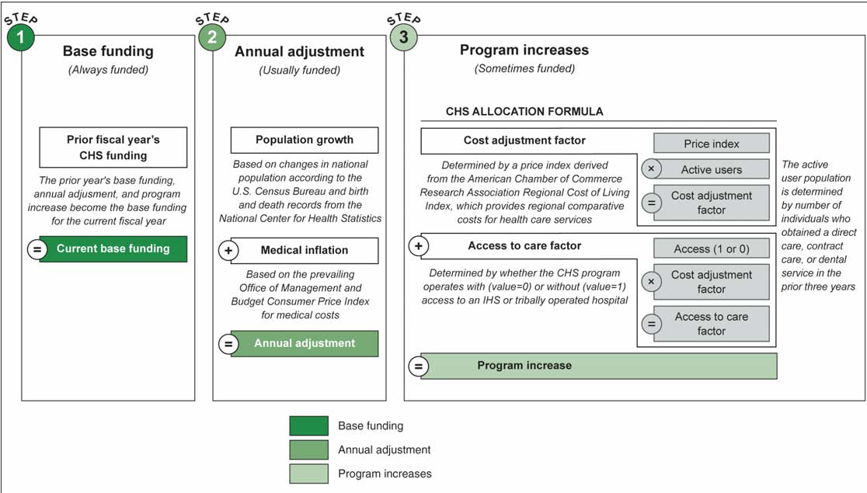
GAO CHS Study

Slide 15
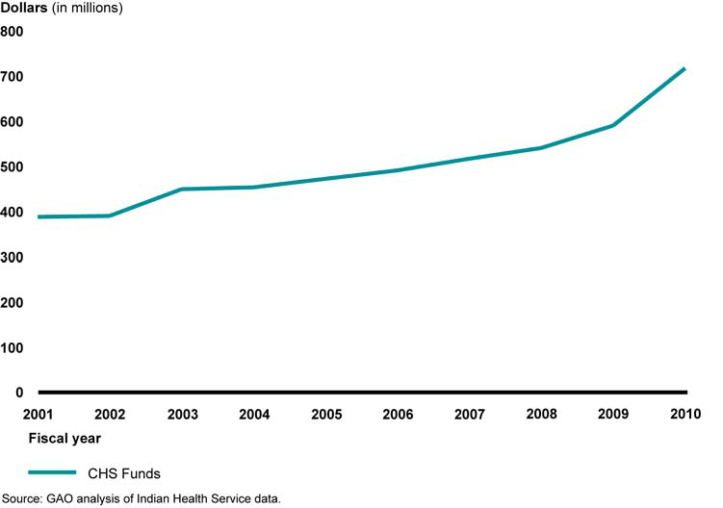
Total CHS Funds Allocated to IHS Area Offices, Fiscal Years 2001 through 2010

Slide 16
Funds allocated to area offices, in dollars, for fiscal year 2010
Area Base Funding | Base funding | Total adjustmentsa | Program increase | Total CHS funding | IHS active user count | Per capita total CHSfunding
Oklahoma | $75,827,291 | $3,323,888 | $16,114,000 | $95,265,179 | 318,923 | $299
Navajo | 69,437,474 | 3,090,855 | 12,458,000 | 84,986,329 | 242,331 | 351
Phoenix | 51,570,656 | 2,278,464 | 9,200,000 | 63,049,120 | 159,166 | 396
Albuquerque | 29,830,959 | 1,327,724 | 6,023,000 | 37,181,683 | 85,946 | 433
Bemidji | 41,868,282 | 1,865,264 | 8,631,000 | 52,364,546 | 102,782 | 509
California | 31,420,785 | 1,400,292 | 7,952,000 | 40,773,077 | 78,682 | 518
Alaska | 63,065,563 | 2,808,647 | 9,907,000 | 75,781,210 | 138,298 | 548
Nashville | 24,243,805 | 2,012,527 | 3,899,000 | 30,155,332 | 51,491 | 586
Aberdeen | 67,932,811 | 3,026,350 | 7,949,000 | 78,908,161 | 121,903 | 647
Tucson | 14,805,851 | 658,487 | 1,522,000 | 16,986,338 | 25,562 | 665
Portland | 69,230,127 | 3,001,723 | 10,985,000 | 83,216,850 | 104,097 | 799
Billings | 49,214,400 | 2,193,163 | 5,360,000 | 56,767,563 | 70,863 | 801

Slide 17
Federal Facilitated Exchange

Slide 18
State Exchange Work
Exchange Analysis Papers
  Exchange Impact Analysis on Tribal Health Programs
  Justification for QHPs to Contract with Tribal Health Programs
  Tribes as Navigators
  Tribal Sponsorship of Premiums & Group Payer Arrangements
  CO-OP Analysis & Tribes
  Exchange IT Assessment, Tribal identification and documentation
  Indian Definition & Documentation
  Reference Guide to Federal Indian Laws & Regulations for Exchange Planning

Slide 19
Questions/Discussion
Jim Roberts, Policy Analyst
Northwest Portland Area Indian Health Board
jroberts@npaihb.org

